Slide 1

Aleksander’s Summer Research Culmination

Slide 2
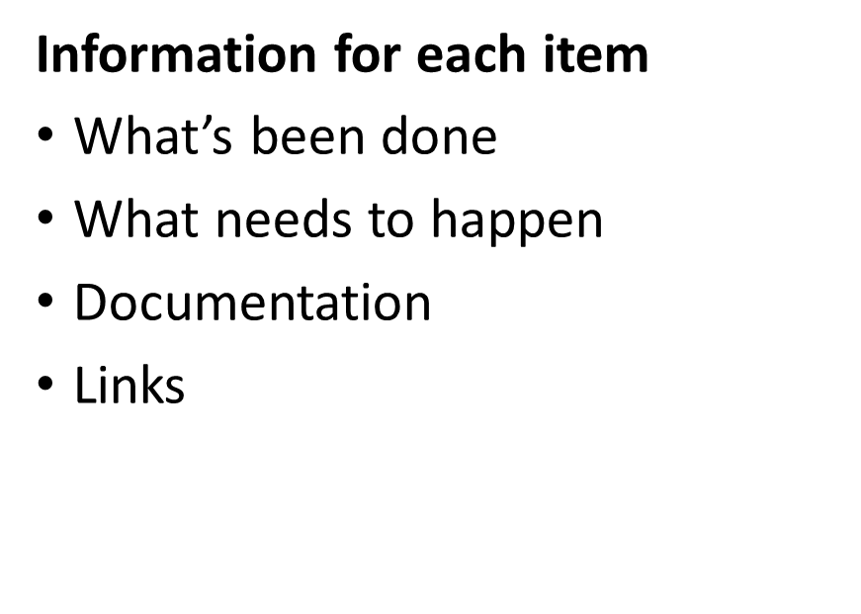
Summary
What I Worked On
Bearing Vibration Analysis Setup
Circular Greases Tribometer
AFM Remote Control
AFM Peak Detection
Vinay Tip Holders
More detailed information can be found at:
https://github.com/thesixtium/2022_summer_research

Slide 3
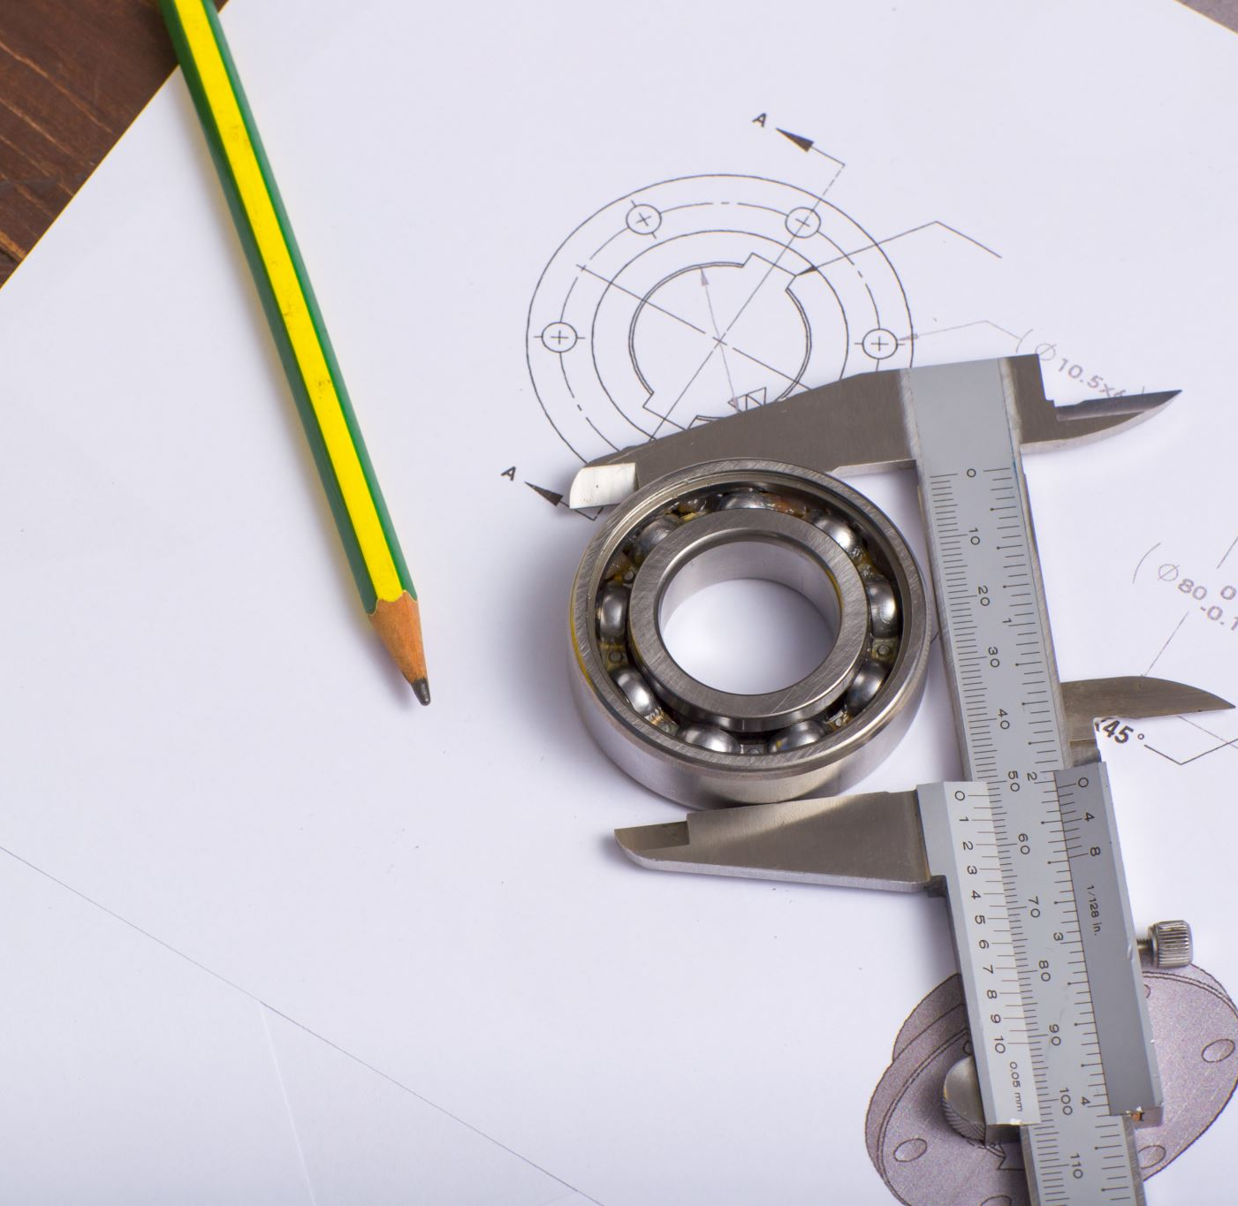
Bearing Vibration Analysis Setup

Slide 4

Overview
Worked on the electrical and software design for this project
Biggest two things were interfacing the motor and the torque sensor
Made good progress but not enough time to finish

Slide 5
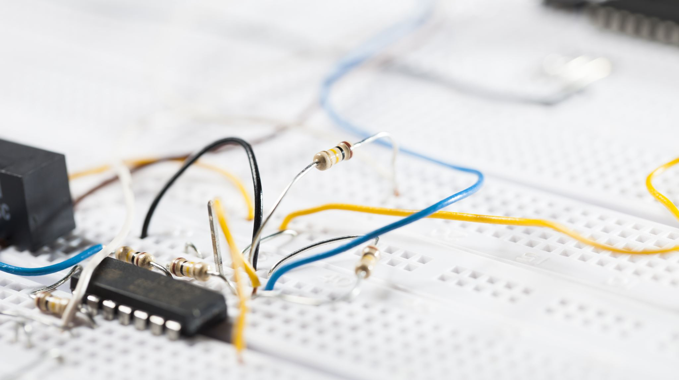
What’s Been Done
Electrical schematics have been done
Version 1 of the electrical was tested
Didn’t reach the full 42V range
Everything else worked
Version 2 of the electrical was tested
Shorts in the board made it not work
Hand soldering the small chip package is painful and very hard to do
Not enough time to do Version 3

Slide 6
What Needs to Happen
Redo circuit board, probably print an actual PCB
Do range scaling and calibration in LabVIEW
I could design a PCB and order it but I’m already gone
Even if rushed it, would arrive after I’m gone
Do design of the accelerometer and brake integration

Slide 7

Documentation
All on the GitHub
“Bearing Information.pptx” is the most up to date on everything
Everything else is supporting documentation

Slide 8
Links
GitHub Project: https://github.com/thesixtium/Bearing_Vibration_Analysis_Setup

Slide 9
Circular Greases Tribometer

Slide 10
Overview
There was a linear tribometer set up already, and some work had been done towards making it circular. All the mechanical had already been set up, so it was mostly assembling it, adjusting parts, and making the software.

Slide 11
What’s Been Done
All the mechanical assembly
Calibration has been done and loaded
Software has been created
Electrical has been cleaned up

Slide 12
What Needs to Happen
Software needs to be modified to run experiments automatically (foundation is set up)
Need to auto-move to run experiments

Slide 13
Documentation
Software is labelled
Powerpoint in the GitHub

Slide 14
Links
GitHub Link: https://github.com/thesixtium/rotating_grease_tribometer
Zaber Console: https://www.zaber.com/software
Thesis: https://www.ucalgary.ca/sites/default/files/teams/135/Brandon%20Wong%20MSc%20Thesis.pdf
Mini40 Info: https://www.ati-ia.com/products/ft/ft_models.aspx?id=mini40
DMX-J-SA-17 Drivers: https://www.arcus-technology.com/support/downloads/download-category/software-installation/
https://www.arcus-technology.com/support/downloads/download-info/drivemax-series-installer/
https://www.arcus-technology.com/support/downloads/download-info/drivers-and-tools-installer/

Slide 15
AFM Remote Control

Slide 16
Overview
The goal of the AFM Remote Control items was to be able to control the AFM remotely and access all data from the desktop instead of needing to read stuff off of the machines

Slide 17
What’s Been Done
Found they prebuilt software
Figured out how to set it up

Slide 18
What Needs to Happen
Integrate the LabVIEW stuff
Lots of links on PreVac’s site are broken / contain incorrect information, making it hard to get all the software needed

Slide 19
Documentation
Next slide is on Heat3.exe Setup Instructions
Should be the same procedures for all PreVac stuff
Also a link with documentation

Slide 20
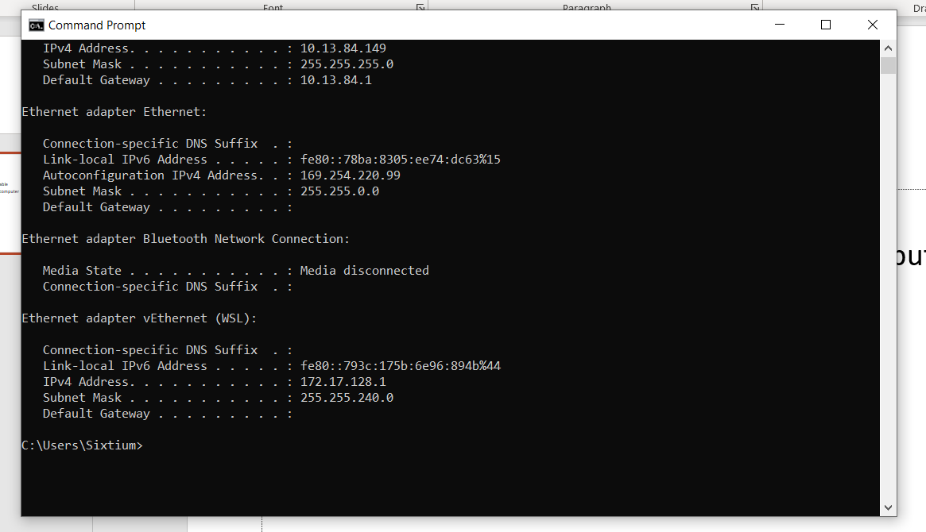
Heat3.exe Setup Instructions
Connect Heat3 unit to computer via Ethernet cable
Open up command prompt on connected computer
Type in ipconfig
Take note of Ethernet adapter Ethernet heading
Copy down Autoconfiguration IPv4 Address and Subnet Mask
Enter the IP Address and Mask into the Heat3 under Device Settings -> Communication
Open up PreVac’s “Heat3.exe” program
Make sure the IP Address and Mask are the same IP Address and Mask as before
Connect

Slide 21
Links
Downloads: https://www.prevac.eu/en/c,6,download.html
Firmware: https://moplink.prevac.pl/fsdownload/DOnc5VJEi/Firmware
Software: https://moplink.prevac.pl/fsdownload/aSfFCUArk/Customer_Download

Slide 22
AFM Peak Detection

Slide 23
Overview
This code is meant to automate the process of finding peaks and valleys in AFM data and do all the needed math, turning hours or days of work into under a minute of computing.

Slide 24
What’s Been Done
Designing the base framework
Testing and tuning on one dataset
Actually running it and having it work

Slide 25
What Needs to Happen
More testing and adjustments on other datasets
Application of the software

Slide 26
Documentation
Found in GitHub repository
Also found throughout code

Slide 27
Links
Link to entire project: https://github.com/thesixtium/AFM_Peak_Detection

Slide 28
Vinay Tip Holders

Slide 29
Overview
Vinay asked for holders for the AFM tips, I have no idea what they are used for or why they are needed.

Slide 30
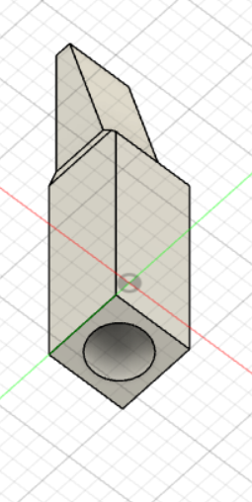
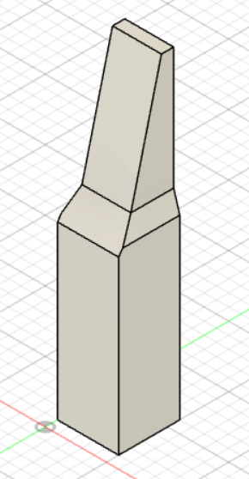
What’s Been Done
I made and printed it

Slide 31
What Needs to Happen
Nothing

Slide 32
Documentation
It’s a 3D print, there’s no documentation

Slide 33
Links
Link to the files: https://github.com/thesixtium/Vinay_Tip_Holders

Slide 34
Contact Information
Email: aleksander.berezowsk@ucalgary.ca
Website: https://thesixtium.github.io/
Time zone: I live in Calgary
Availability: I’m happy to come in and clarify stuff every so often, but there’s no set time that works best

